Slide 1
Final Project
Dataset Challenge
Team 5
Madhav Sahu
Rohit Singh
Shrenik Jain

Slide 2
Yelp Dataset Challenge
In recent years, Yelp has made subsets of its data available to the public to promote innovative uses of data and groundbreaking research.
The Challenge Dataset:
2.2M reviews and 591K tips by 552K users for 77K businesses
566K business attributes, e.g., hours, parking availability, ambience.
Social network of 552K users for a total of 3.5M social edges.
Aggregated check-ins over time for each of the 77K businesses
Problem Statement: Challenge is to use this data in an innovative way to provide prediction and visualization to the end user.

Slide 3
Our Goals & Objectives
Predict the rating of a restaurant.
Identify which attributes of a restaurant can affect its ratings on yelp.
Is it possible, if we improve the ambience, parking, and so on of a restaurant than it can result in a better business rating on yelp?
If anyone is planning to open a new restaurant of particular ethnicity type than what can be desired attributes for getting a decent rating on yelp?
End User : Restaurant owners
Identify area of improvement
New

Slide 4
5 Step Data Preparation Process
Data Access
Data Understanding
Data Extraction & Consolidation
Data Cleaning
Data Transformation & Reduction

Slide 5
Data Access
Our data was downloaded from the Yelp Dataset Challenge web page. The URL for that page is http://www.yelp.com/dataset_challenge
The Challenge Dataset:
1.6M reviews and 500K tips by 366K users for 61K businesses
481K business attributes, e.g., hours, parking availability, ambience.
Social network of 366K users for a total of 2.9M social edges.
Aggregated check-ins over time for each of the 61K businesses
From the data, we focused only on records associated with restaurants in US. The processing of consolidating and cleaning the data is outlined in the sections that follow.

Slide 6
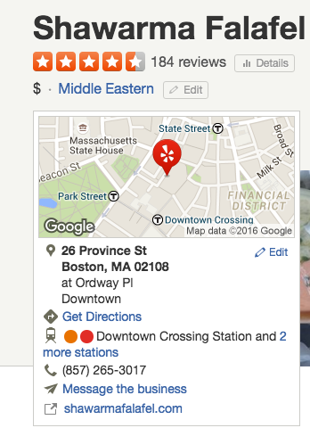
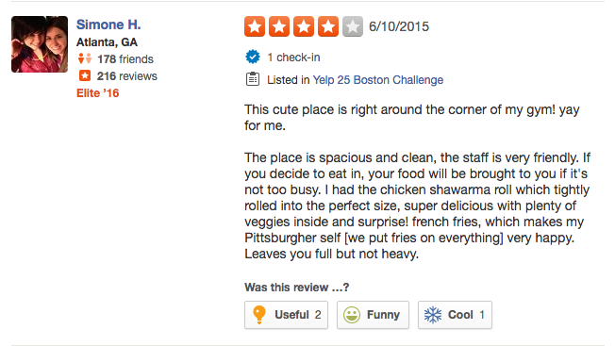
DATA UNDERSTANDING
USER’S REVIEW
BUSINESS OVERALL RATING

Slide 7
DATA PROCESSING: Using R
DATA EXTRACTION AND CONSOLIDATION:
Extract the data from JSON format to csv format.
DATA CLEANING:
Restricted the data contains restaurants that are in US only.
Created a new merged business file with different ethnicity type.
Cleaned the column names
DATA TRANSFORMATION AND REDUCTION:
Determine the important attributes of restaurants that can have impact on restaurant’s rating.
Removed the columns that contains more than 70% of values as N/A
Reduced the similar attributes into a single attribute with weightage

Slide 8
Data Visualization
Visualize the box plot of all important factors to show the range of ratings and number of ratings received depending on importance

Slide 10
These charts show the rating received by different ethnicity types and the number of reviews received.
The ratings ranged from 1-5 and the ethnicity had 13 types.

Slide 11
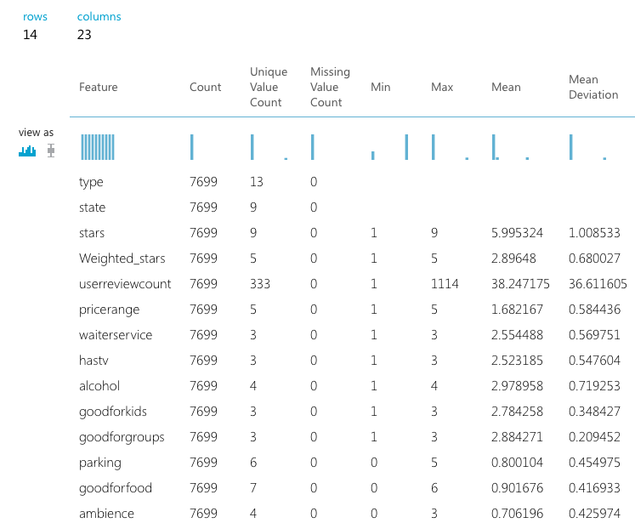
Model building
After visualization and understanding the data better we build the model in Azure.
Before building model we pre-processed the data using Meta-Data Editor and Project Column. In Meta-Data Editor we specified the categorical values like Type, State and City
In Project Column we selected the variable that were important in building a model keeping in mind about user’s perspective as if inputs that we will take in the front end is relevant to user.

Slide 12
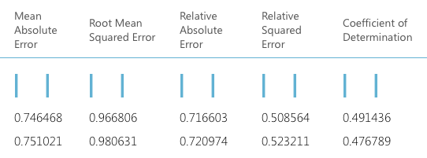
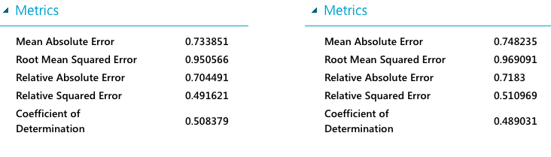
After the data was processed we split the data in to 70% Train Data and 30% Test Data and ran all model and evaluated the models in the end.
We have used Boosted Decision Tree Regression, Decision Forest Regression, Linear Regression and Bayesian Linear Regression model and tried to evaluate on the basis of RMSE and AME to determine best model for our dataset.
1st Row -> Bayesian Linear Regression
2nd row -> Decision Forest Regression
Left metrics-> Boosted Decision Tree Regression
Right metrics-> Linear Regression

Slide 13
Model Selection
Boosted Decision Tree Regression is the best predictive model as it’s RMSE and AME is minimum and Co-efficient of Determination is maximum as compared to other models.
Root Mean Squared Error: 0.950566
Coefficient of Determination: 0.508379

Slide 14
DEPLOYING WEBSERVICE:
After modeling we deployed it as a web service in AML to generate the restful API so that we can use the API in the frontend.
. NET Framework:
We used .NET for using the API for prediction.
Published our tableau visualization in public tableau
Also plotted bar charts to dynamically display the ratings using JavaScript

Slide 15
Website:

Slide 16
Technology/Tools Used:
R
Microsoft Azure
Model using Azure, R Studio and XLMiner
Tableau
JavaScript
Bootstrap
.NET

Slide 17

Thank You!!

